Slide 1



Strategy of STEAM EDU with AI
TARKUSTECH INNOVATIONS
Motivate K to K-12 students to learn programming and AI-IoT
Improving of STEAM education
Tarkustech Innovations Co. Ltd. Copyright 2022

Slide 2
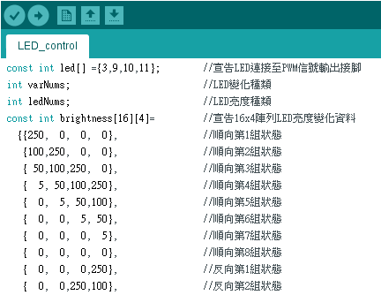
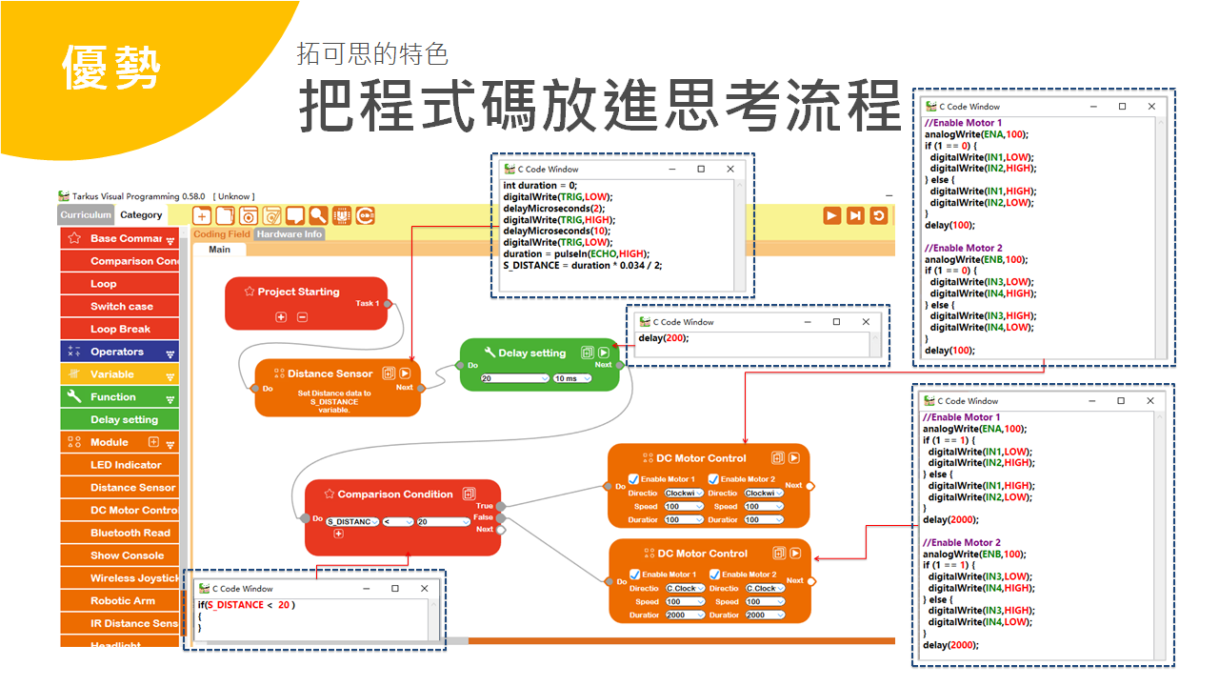
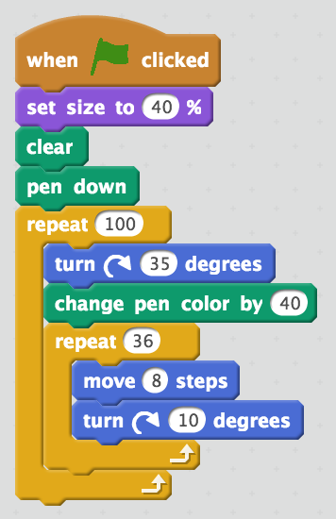
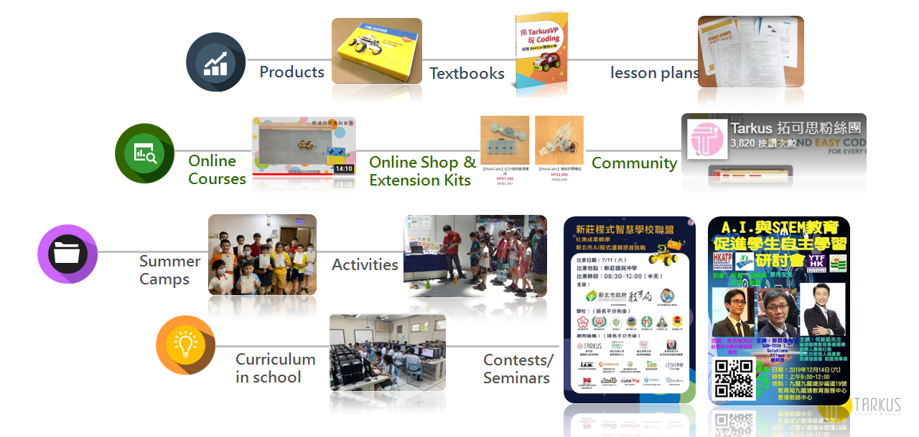
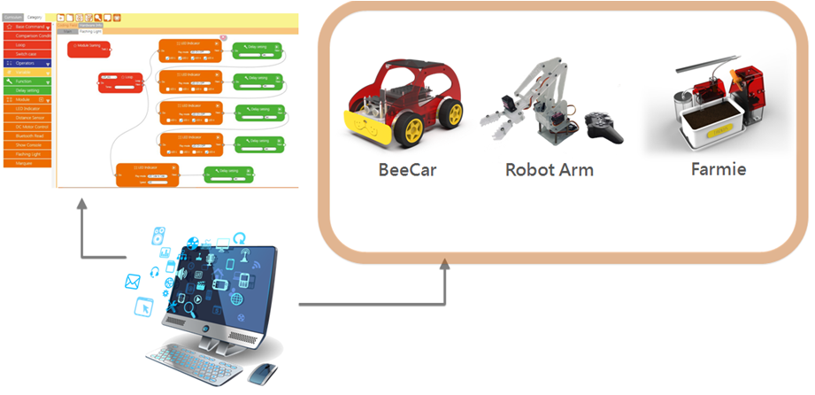
Computer Science & Design Thinking
Program syntax
Logics and Algorithm
Programming
Profession

Slide 3
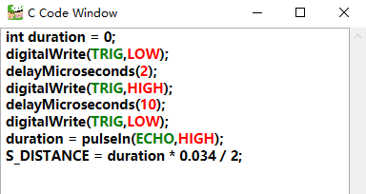
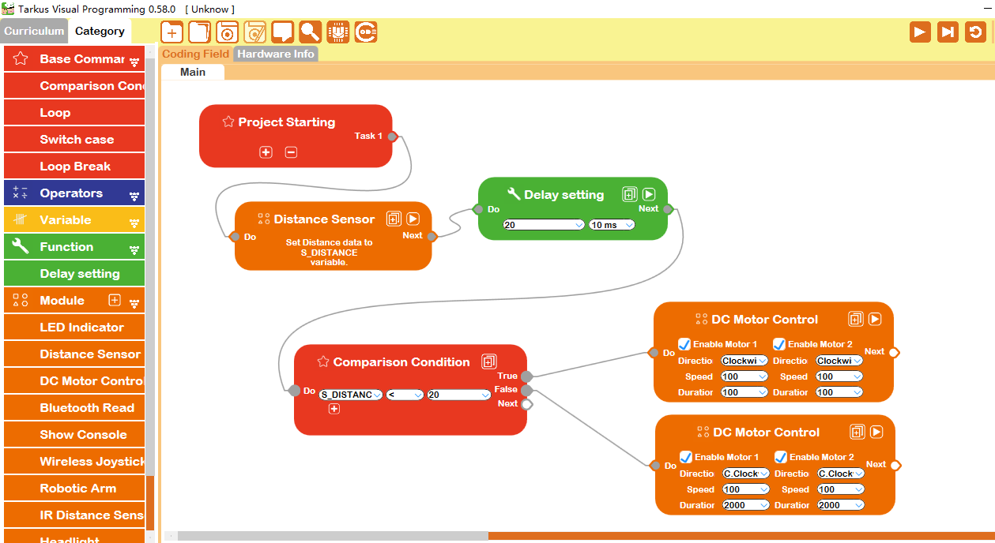

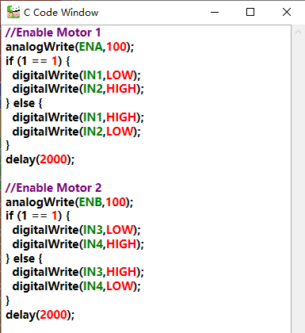

Realize the Flow-base concept
Use Flow Chart to Start Coding
Separate code by FBP
The purpose of this software, Tarkus VP, is to make students easier to learn programming logic and the basic concept of AI algorithms.
Notes:
拓可思的突破
把程式碼階段分解

Slide 4
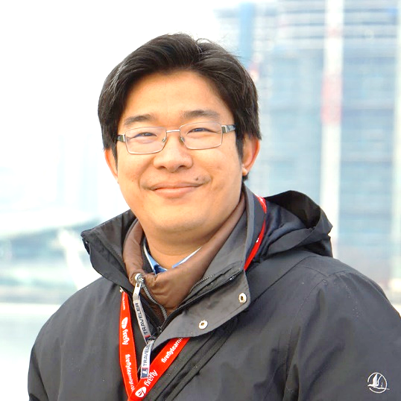









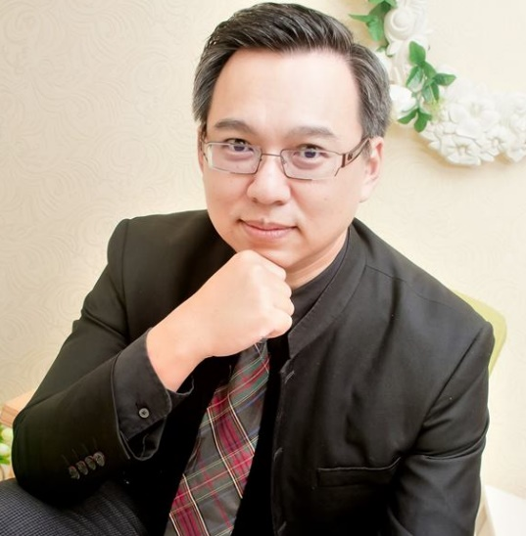

Partners & Consultants
Dr. Fu-Yuan Chiu
National Tsing Hua University
Department of Education and Learning Technology
Prof. Huei-Tse Hou
National Taiwan University of
Science and Technology
Graduate Institute of Applied Science and Technology
7

Slide 5
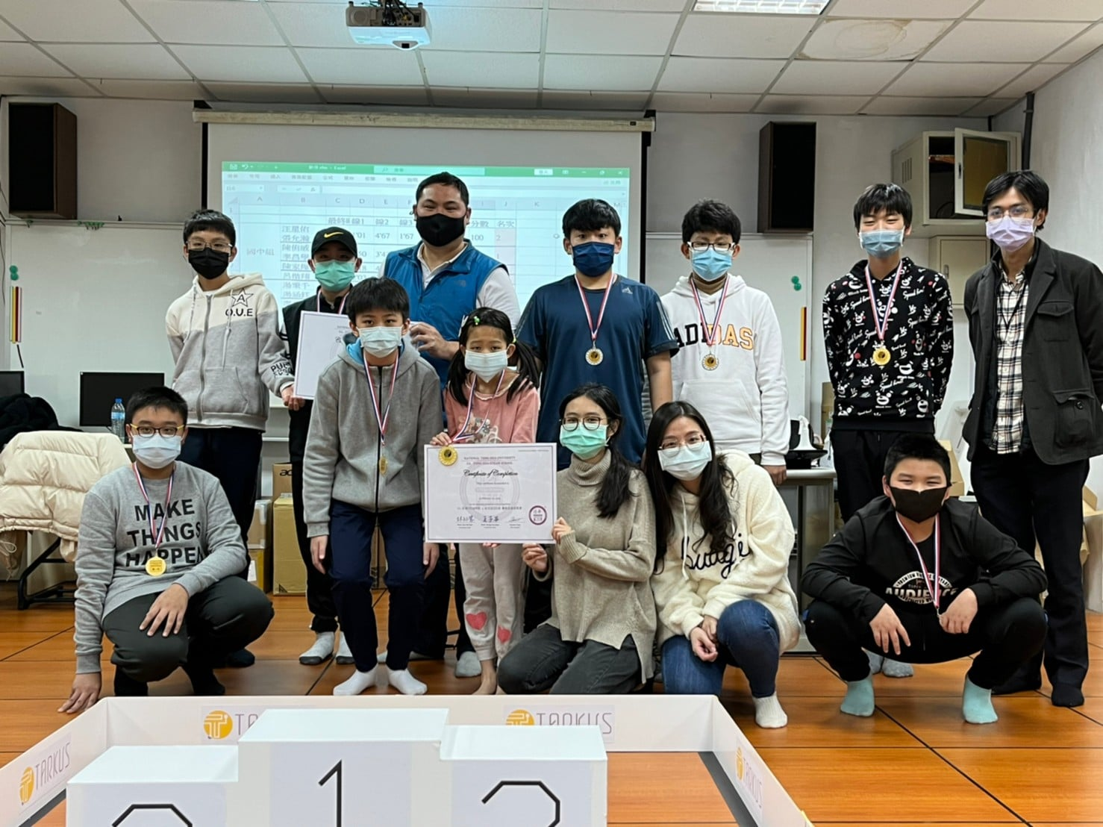
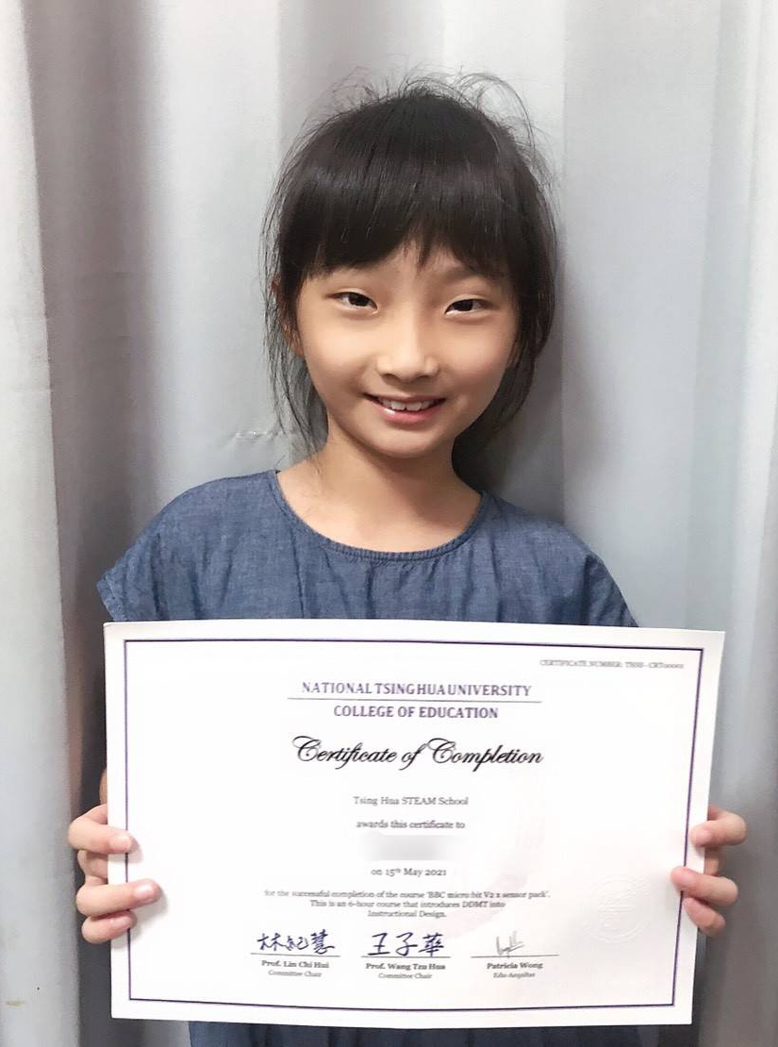
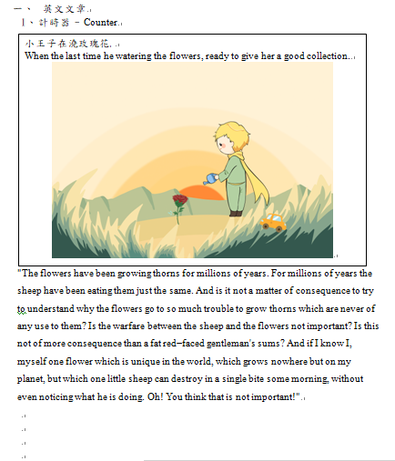
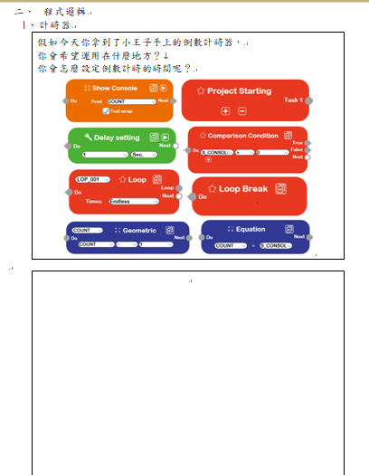
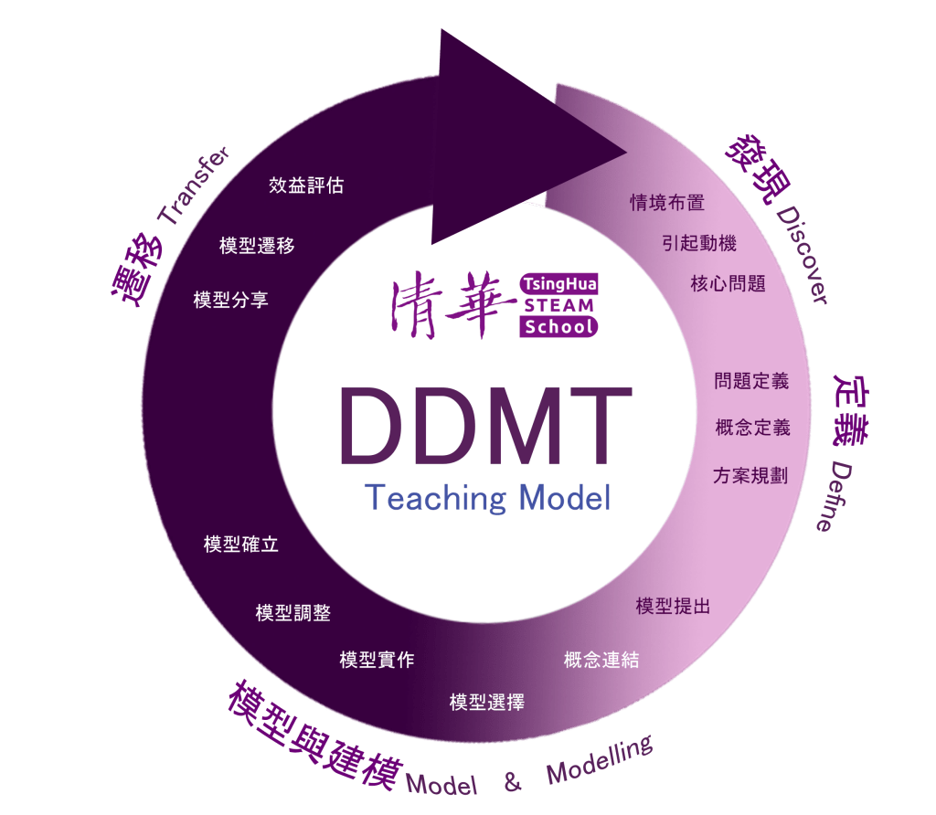
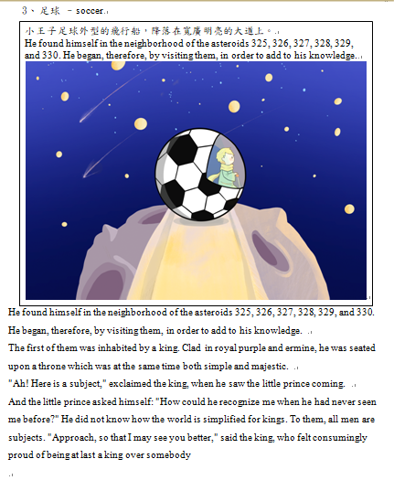
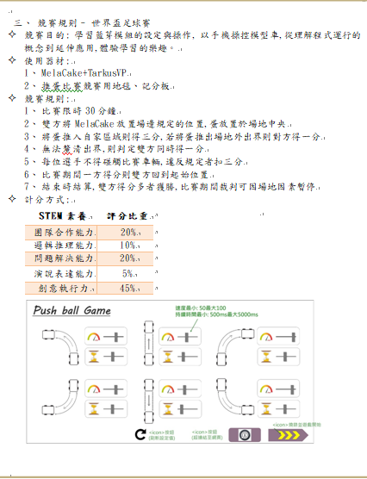
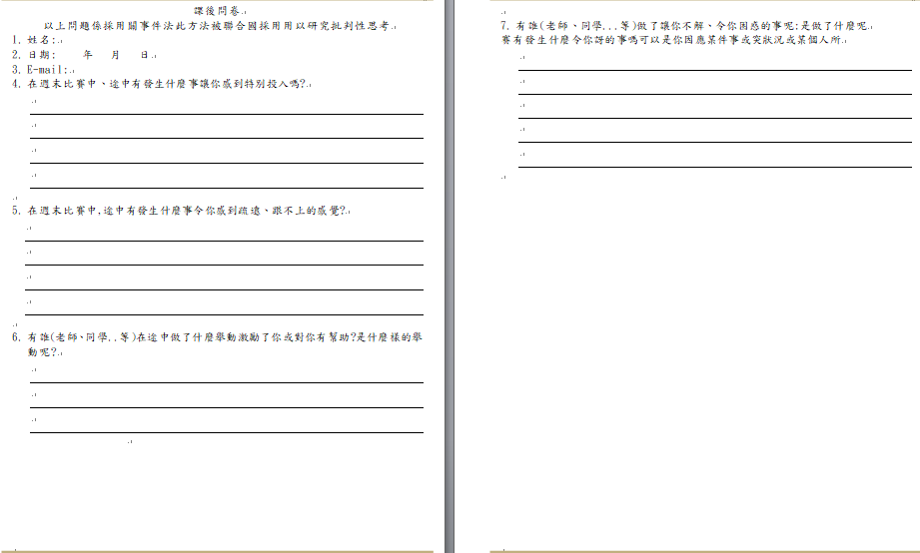
DDMT & EA-Tsing Hua STEAM certificate
Story of task
Flow of Thinking
Tasks and Gaming
Feedback & Critical thinking
5

Slide 6
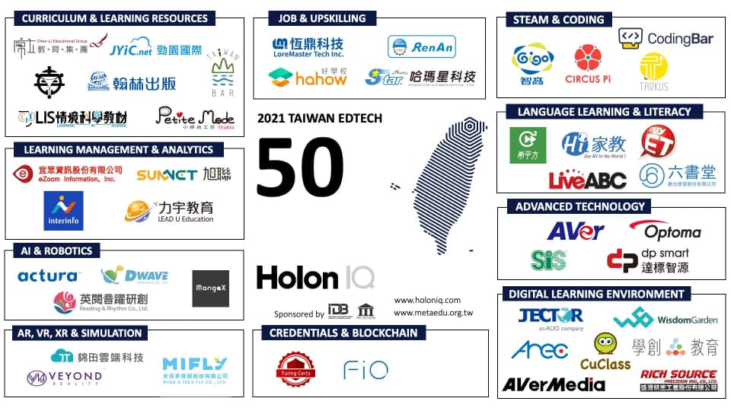
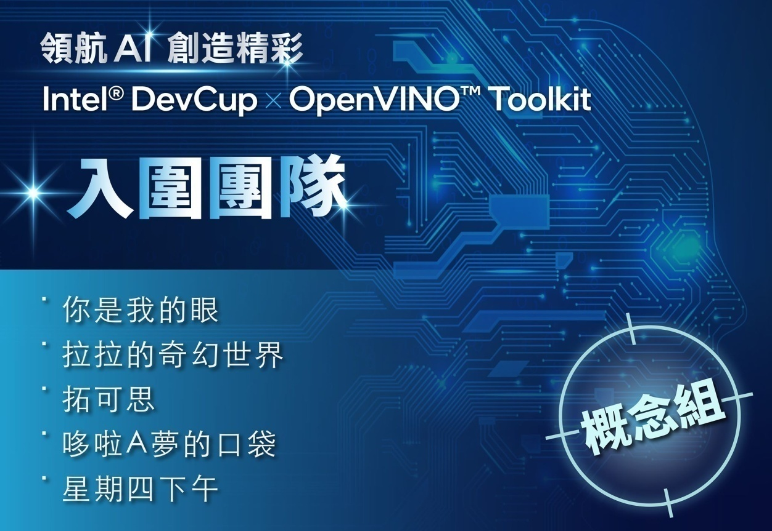
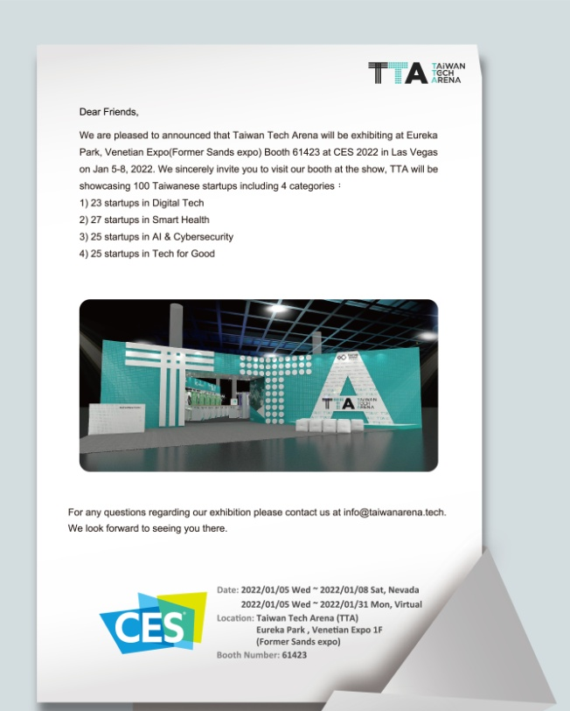
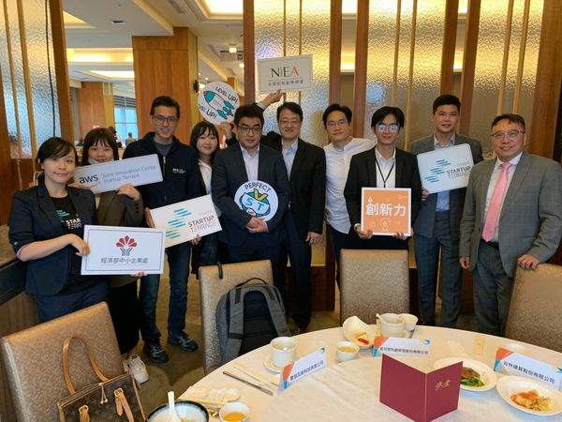
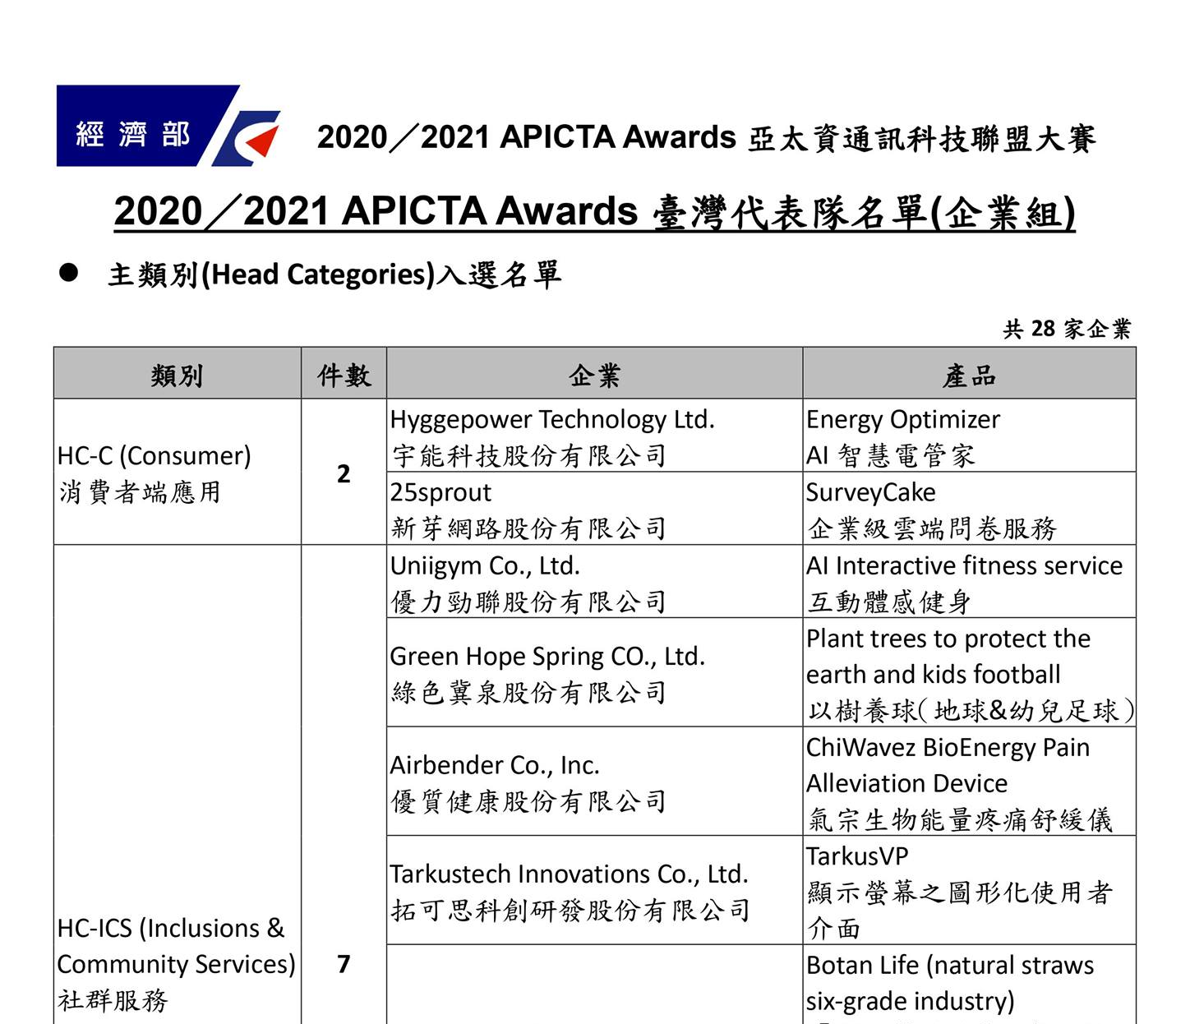



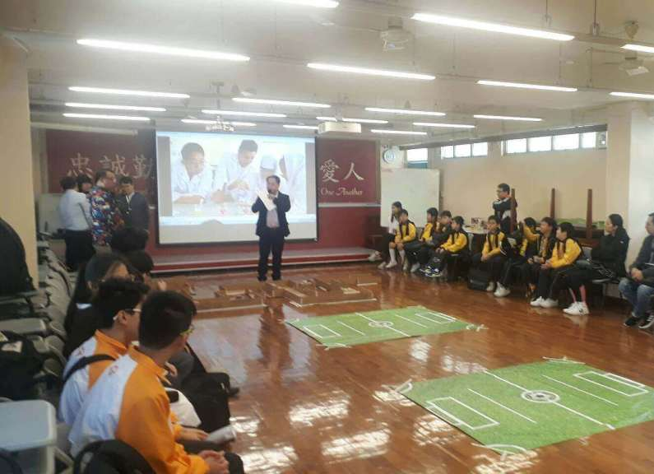
Global Awards and Workshops
2022 US CES
new product: Farmie
Amazon
AWSJIC
2021 Holon IQ
TAIWAN EDTECH 50
Finalist of
2021 Intel DevCup
2021 APICTA Awards
Taiwan Finalist
Partnership with iii
to join Worlddidac 2021
Partnership with Hong Kong HKEDA institution:
workshops with Education Bureau
contest for 4⁺ schools

Slide 7
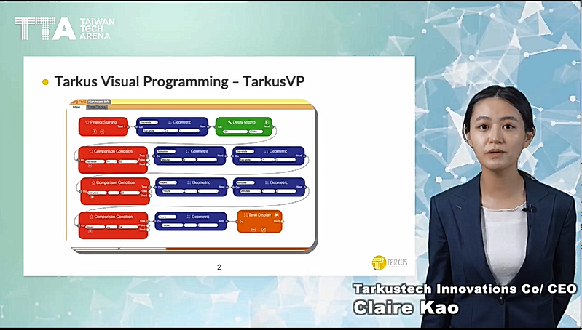

Video
Tarkustech Introduction
https://youtu.be/NQzMS9YfH9E

Slide 8

Value Proposition
Curriculum Goal：Coding for A.I. from beginner to be a programmer
Why us
Use the intuitive interface to learn the fundamental of programming
Learning map link to A.I. and IoT, it benefits on future career conducting
Curriculum topics connect to AIoT life applications and link to future life

Slide 9
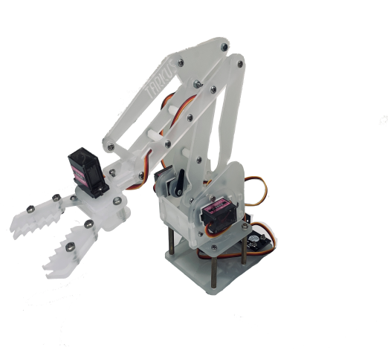
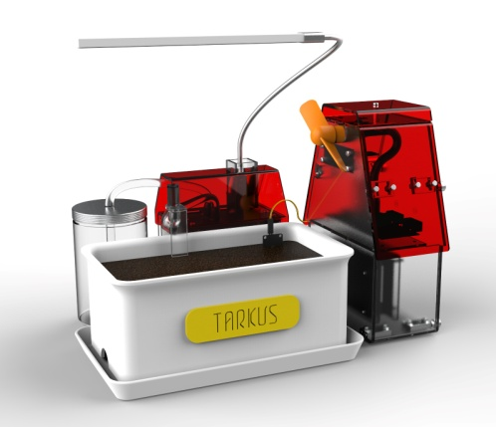

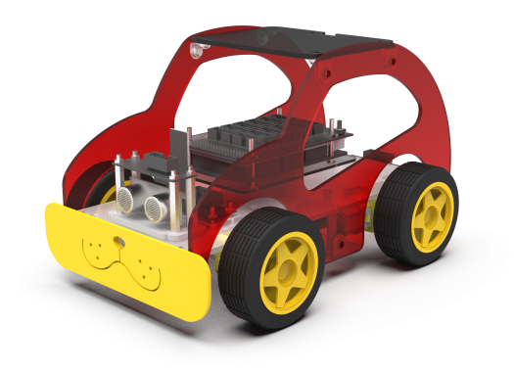

STEAM Learning Map – Future level & Link to AIoT
Level | Age | Learning Target | Main Field | STEAM Theme Stage A | STEAM /Theme Stage B | STEAM /Theme Stage C
Level 9 | 16~18 | AI: Deep Learning Practice | Deep Learning | Numpy | Pandas | TensorFlow
Level 8 |  | Aiot applications | Edge AI | Pixetto | Pixy2 CMUcam5 | Intel OpenVino
Level 7 |  | AI Basic: Machine Learning | Object Detection | Teachable Machine + ESP32 Cloud AI recognition |  | Intel DevCloud
Level 6 |  | Advanced Programming | Algorithms | Algorithms | Data Structures | Data Analysis
Level 5 | 15~17 | Programming Basic | ICT Basic | C++ | VBA/C# | Python
Level 4 | 13~15 | Arduino Projects & Practices | Electro-Mechanism | BeeCar MakerVer | Robotic Arm MakerVer | ESP32 Basics
Level 3 | 11~13 | TarkusVP to Arduino | TarkusVP to Arduino | BeeCar/Arduino | Robotic Arm/Arduino | Smart farm/Python
Level 2 | 9~11 | TarkusVP | TarkusVP | BeeCar/TarkusVP | Robotic Arm/TarkusVP | Smart Farm/TarkusVP
Level 1 | 7~9 | Scratch to TarkusVP Basics | Scratch to TarkusVP | Scratch & BeeCar | Scratch & Robotic Arm | Scratch & Smart Farm
Level 0 | 5~7 | Creative Gaming | Coding Logics | Papago board games | CuPia Blocks | 3D Pens
ICT & AIoT
Advanced applications
Computer Science
Academic Subjects
STEAM & Coding
Robotic foundations
Tarkustech Innovations

Slide 10
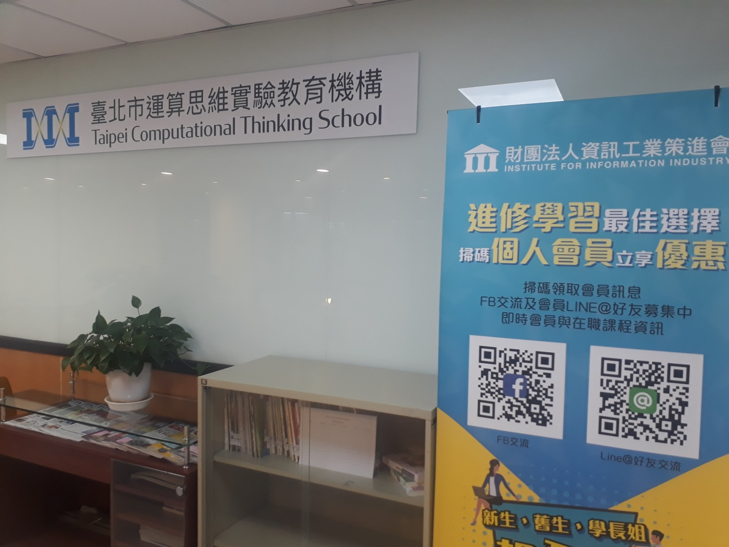

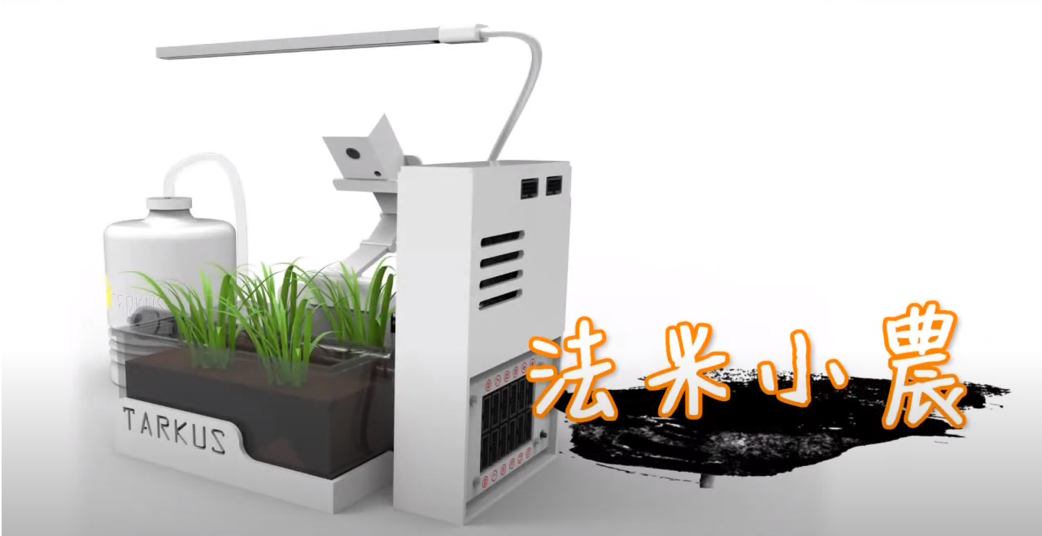
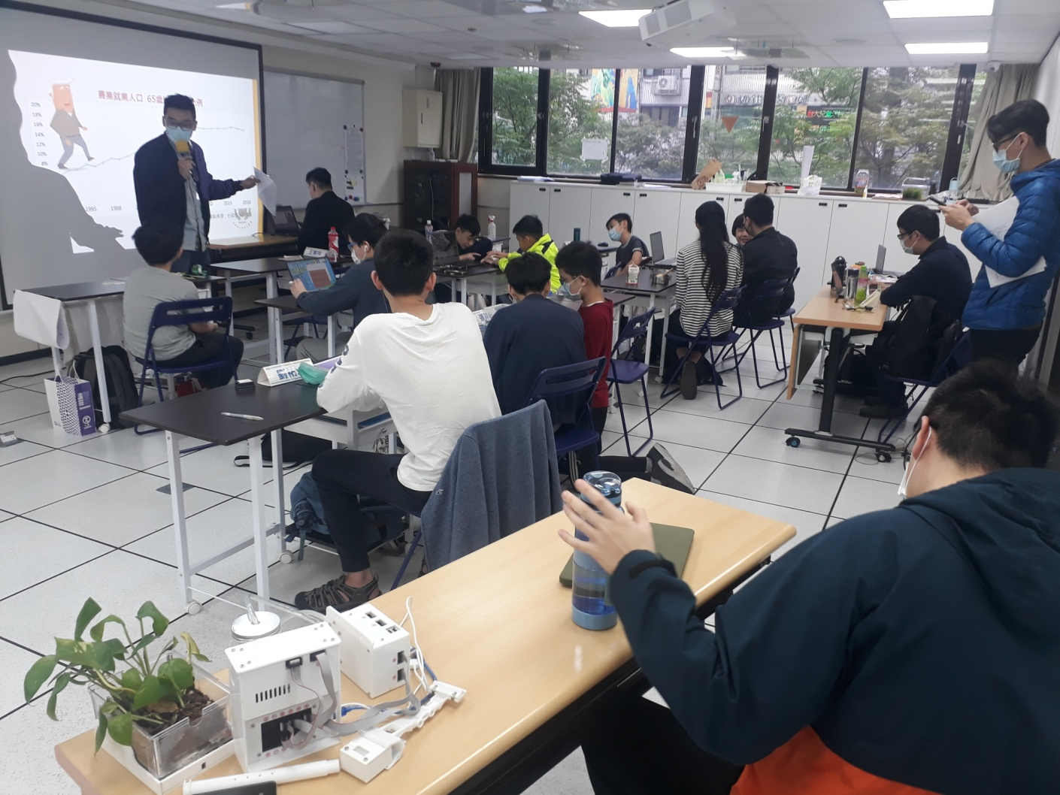
Video
Farmie introduction
https://youtu.be/kfcy8VQTzsA
Since 2020.4.20 @ 資策會

Slide 11

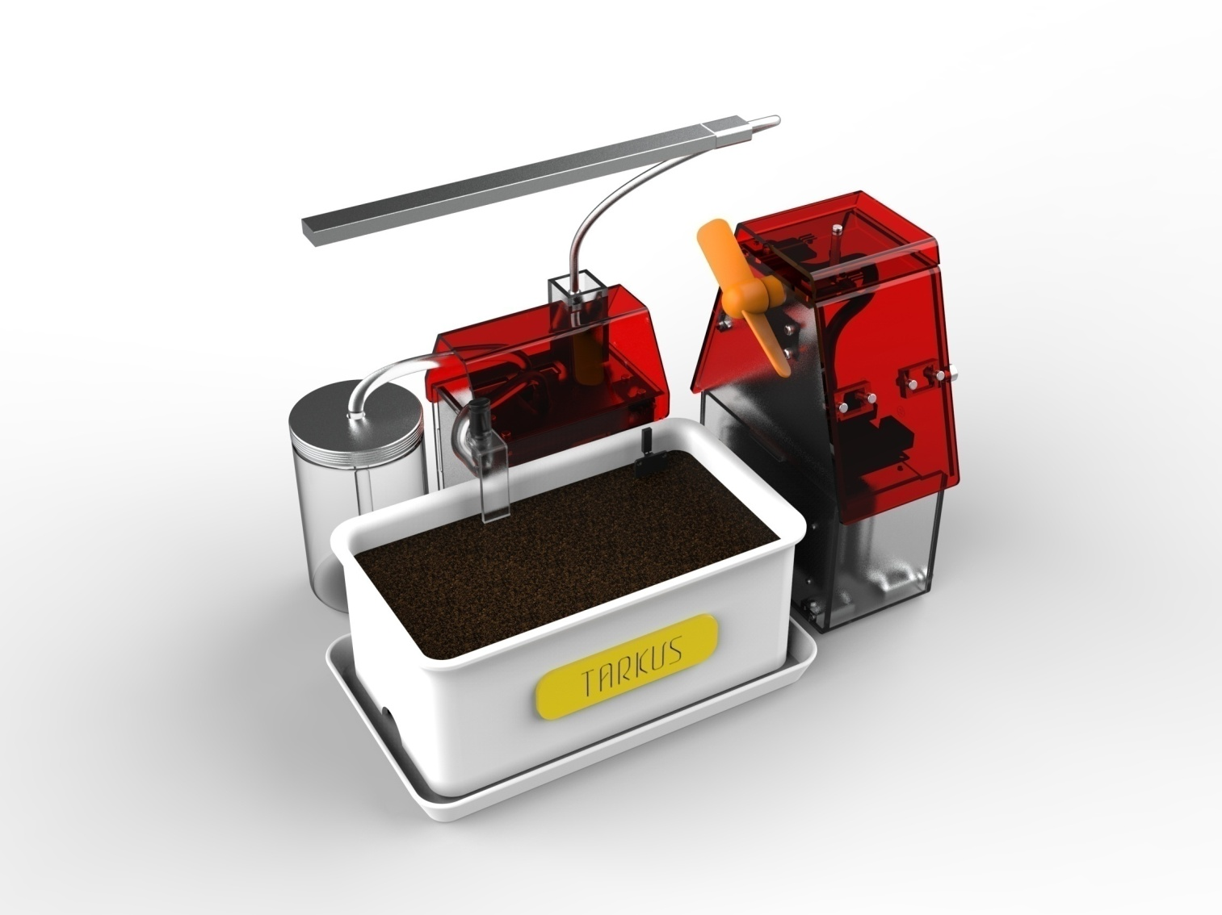
Interface
Hardware Control Modules
Basic Modules on Software
New modules for
Machine Learning
RGB Indicator
Buzzer
Website cloud dashboard
IOT Board
ESP32+CAM
Monitoring on website
SD card storage
Battery & power module
Fan
Read data via Wifi
Power Board
Fans
Water pump
USB planting light
Battery
Water pump
Capturing pictures
Planting light
Data storage
Image Recognitions with ESP32
Video streaming
Picture recognition
Color recognition
Support C / C ++ & Python
UART interface
Temp/Humid Read
Clock Timer
Sensor Board
T/H Sensor dht11
Soil Humidity
Light Sensor
Rain Drop Sensor
RGB Indicator LED
Buzzer
Soil Humid Read
Export data WiFi
Light Sensing
Battery & Power
Rain Drop Sensing

Slide 12
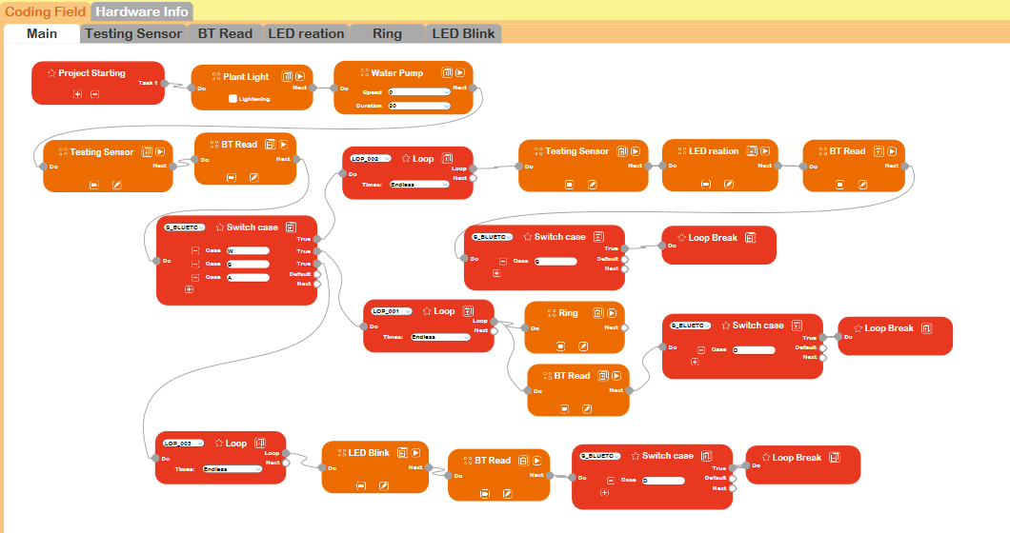
Interface
Software Design Interface
ACTIONS SETTING
WORK FLOW

Slide 13
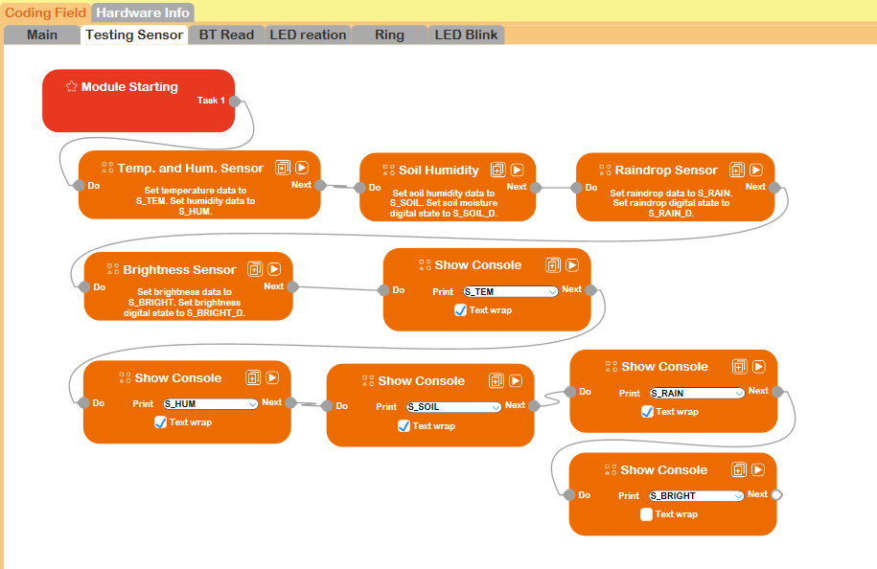
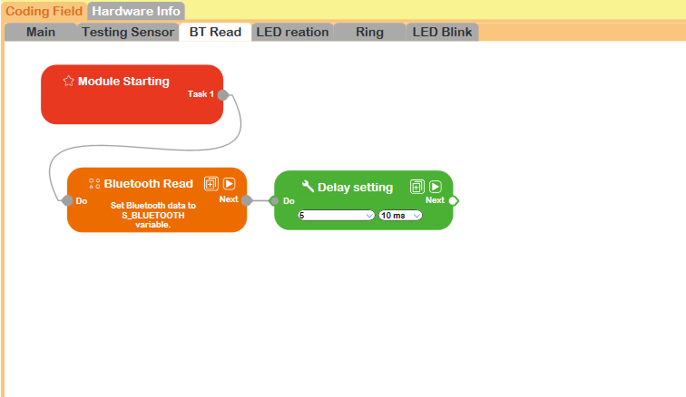
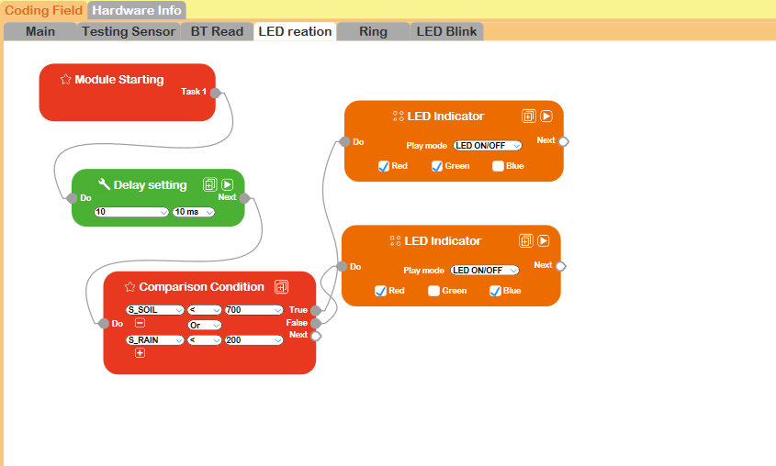
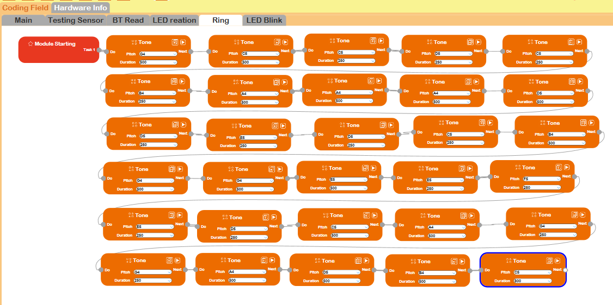
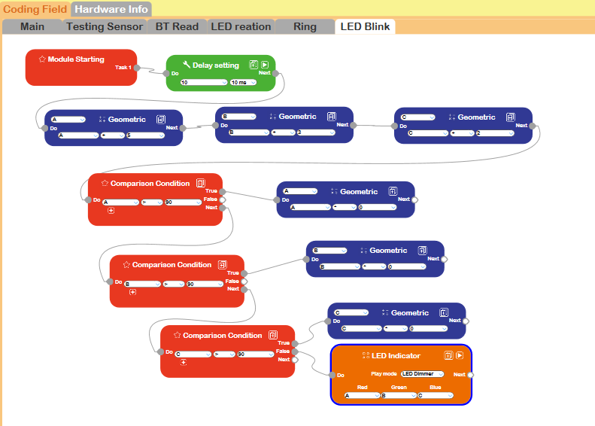
Interface
Software Design Interface
ACTIONS SETTING
Sensor Testing
Bluetooth Read
LED reactions
Ring Tones
LED Blink

Slide 14
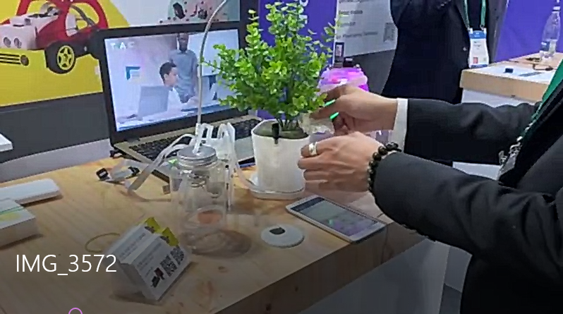

Video
Demo in CES 2022
https://youtu.be/5WdNmFEPRFE

Slide 15
Link to Machine-learning & AI

Slide 16
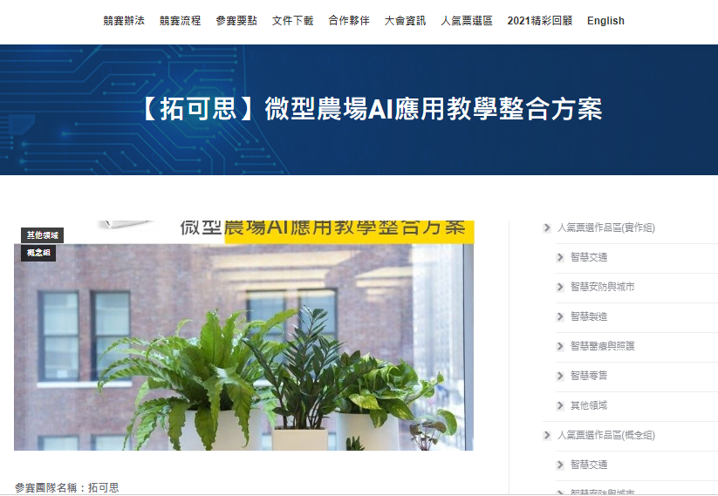

Concept of Machine Learning Class Design:
2021 Intel Devcup OpenVINO competition
https://makerpro.cc/intel-devcup/微型農場ai應用教學整合方案/

Slide 17




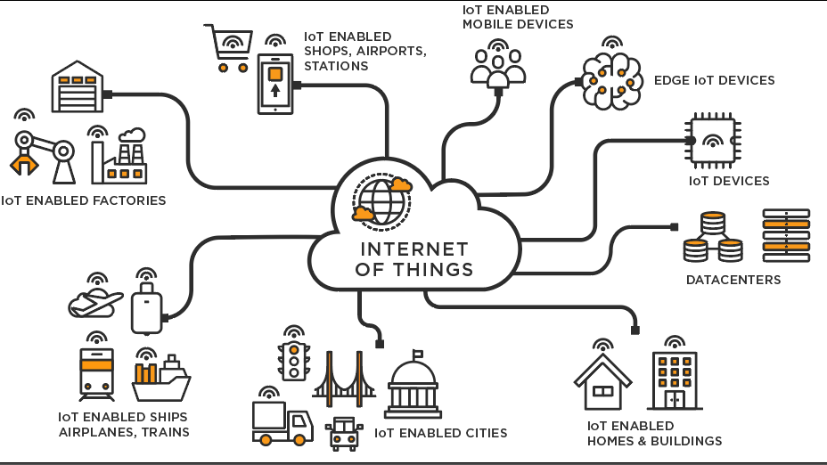
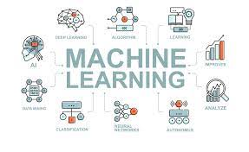
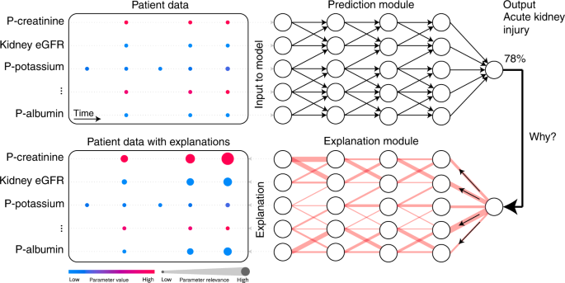

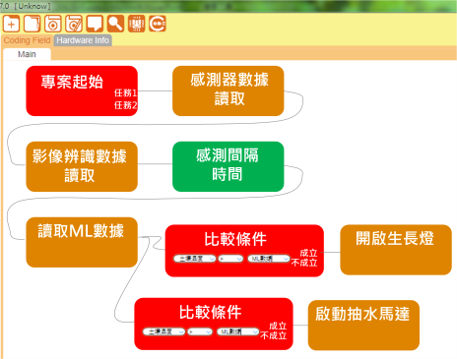
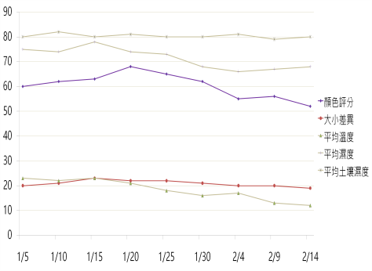

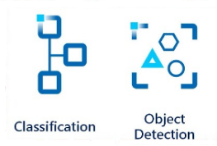


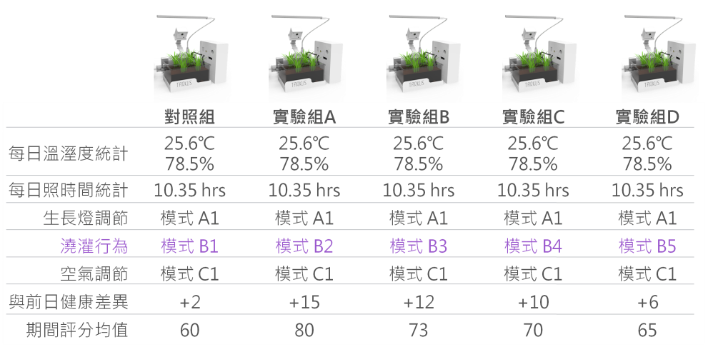
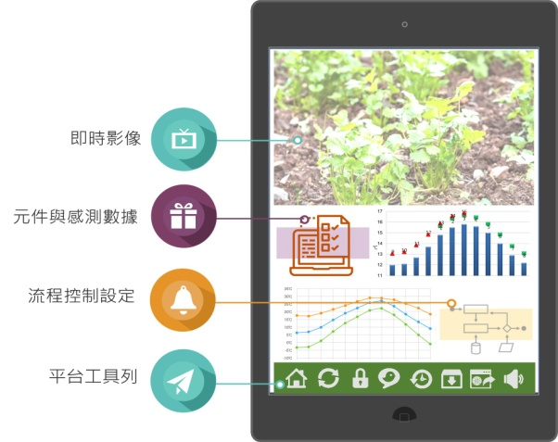
EA-Tsing Hua DDMT design thinking Model
DDMT Model | Design Thinking Stages | Steps and Contents
Discover | Context awareness 情境覺察 Motivation 動機 Core Problem 核心問題
Define | Problem Definition 定義問題 Concept Definition 概念定義 Solution Planning 計畫解決辦法
Model & Modeling | Modelling 模型 Concept Alignment 概念對照 Model Selection 模型選擇
 | Prototyping 原型 Debugging 排除錯誤 Final Model 最終模型
Transfer | Model Sharing 模型分享 Model Transfer 模型遷移 Evaluation 評估
Sun Light
Soil Humidity
Air Temp & Humid
IoT fundamentals
& Introduction
Level1
Image Recognition
& Machine learning
Level2
Data Analysis
& AI prediction
Level3
17

Slide 18


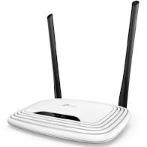
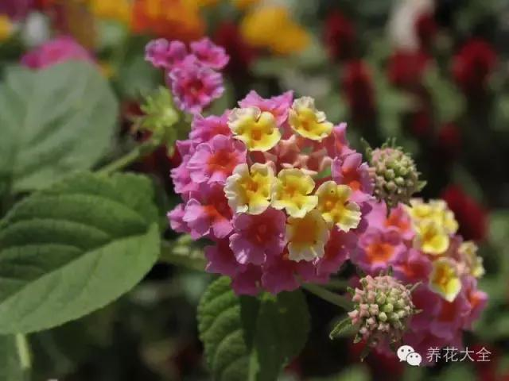



Concept of Machine Learning Class Design
Modeling & Building
Model Optimization
Deployment
Regularly take photos and upload to cloud
Identifying flowers from photos
Data to Edge Server
Each photo has a data field
Date & time
Expected identification of flower species
Soil moisture (watering behavior)
air temperature and humidity
Sunshine and light hours
Score (default is 0)
Image Capture system

Slide 19

Concept of Machine Learning Class Design
Modeling & Building
Model Optimization
Deployment
Factors
Score of Target Analysis
Regularly take photos and upload to cloud
Identifying flowers from photos
Flower condition (health status)
Number of flowers
soil humidity, air temp. and humidity
- ML adjusts watering behavior, air conditioning
Sunshine time and grow light time calculation
- ML adjusts the time of plant lights
Experiment
Comparison of data corresponding to image recognition results
Enter data into database
Intel DevCloud Sample Applications

Slide 20

Concept of Machine Learning Class Design
Modeling & Building
Model Optimization
Deployment
Factors
soil humidity, air temp. and humidity
- ML adjusts watering behavior, air conditioning
Sunshine time and grow light time calculation
- ML adjusts the time of plant lights
 | Original | GroupA | GroupB | GroupC | GroupD
Temp & Humid per day | 25.6℃ 78.5% | 25.6℃ 78.5% | 25.6℃ 78.5% | 25.6℃ 78.5% | 25.6℃ 78.5%
Sun light | 10.35 hrs | 10.35 hrs | 10.35 hrs | 10.35 hrs | 10.35 hrs
Plant Light Mode | Mode A1 | Mode A1 | Mode A1 | Mode A1 | Mode A1
Watering | Mode B1 | Mode B2 | Mode B3 | Mode B4 | Mode B5
Air condition | Mode C1 | Mode C1 | Mode C1 | Mode C1 | Mode C1
Healthy | +2 | +15 | +12 | +10 | +6
Average Score | 60 | 80 | 73 | 70 | 65
Experiment
Comparison of data corresponding to image recognition results
Enter data into database
Scoring Healthy
- Disparity States
- Image recognition to upload photos difference from past
Scoring Elements:
- Flower condition (health status)
- Number of flowers

Slide 21



Concept of Machine Learning Class Design
Modeling & Building
Model Optimization
Deployment
Edge or Cloud guide
Growing analysis
Upload pictures to cloud
Analysis of pictures
Scoring for status of plants
Matching the User settings
Scoring for each results
Machine Learning
Spring
Summer
Best parameters
Growing Behaviors
Growing status
Environmental database
Suggestions and plans
Autumn
Winter
Different plants for each season

Slide 22

Concept of Machine Learning Class Design
Modeling & Building
Model Optimization
Deployment
Edged Score System
 | Settings | ML optimized suggestions
Plant Light | Mode A1 | According to sunlight, set plant light with 2.3 hrs
Watering | Mode B2 | According to status, set soil Humid. to 75.6%
Air Temp. | Mode C1 | According to status, set air with 25.1℃; 78.2%
The planting results of each student are graded together
Group A
The best ML parameters
environmental control variable
The act of watering, the act of lighting the sun
Corresponding growth cycle and health status score
Data-corresponding image recognition scoring results comparison
Suggesting optimal parameters under environmental control variables

Slide 23








Concept of System Architecture
Tarkus existed systems
Cloud Encryption
Data Base
Frontend website
Value-added
Service
Flow Interface
Farmie IoT Kits
Data source of growing
影像辨識API
ML伺服器
Club/ Summer camp
Practice
Teaching-aids
STEM &AI Classroom
Synchronized online teaching
Lesson plans
Online video platform
/Offline activities for students
Online Video
(PressPlay)
Online teaching plans and resource

Slide 24


Video
Tarkustech in CES 2022
https://youtu.be/Wg8v-jJBvnY

Slide 25
Advantages
Integrations of software and hardware will provide a total solution to STEAM teachers.
Encryption mechanism on server and hardware benefits to members control.
Generate from the place crowed of IT talents – Taiwan, with the full R&D energy and curriculum co-work with top academic institutes: NCTU, NTHU, NTUST.

Slide 26



https://tarkustech.com/
THANK YOU!

